Slide 1

PREPARE FOR A CLOUD DATA ANALYST JOB
By,
Inchara S
4VV22IS041

Slide 2

Capstone Project
A capstone project is a multifaceted assignment, typically at the end of an academic program, where students integrate and apply knowledge and skills gained throughout their studies to a real-world problem or comprehensive research project. It serves as a culminating academic experience and demonstrates a student's readiness for future endeavors.
Key aspects of a capstone project:
Culminating Experience: It's the final major assignment in a course or degree program, representing the culmination of learning.
Real-World Application: Capstone projects often involve tackling practical problems or conducting research relevant to the student's field of study.
Integration of Knowledge: Students synthesize and apply knowledge and skills acquired in previous courses.
Development of Skills: Capstone projects enhance critical thinking, problem-solving, research, communication, and teamwork skills.

Slide 3

Purpose of a capstone project:
Purpose Of A Capstone Project:
Demonstrate Competency:
It provides evidence of a student's ability to apply knowledge and skills to solve complex problems.
Prepare for Future Careers:
Capstone projects bridge the gap between academic learning and professional practice, enhancing job readiness.
Showcase Achievement:
It's a significant accomplishment that demonstrates a student's academic journey and final achievement.
Contribute to the Field:
Some capstone projects may lead to valuable contributions to research, practice, or the community.

Slide 4
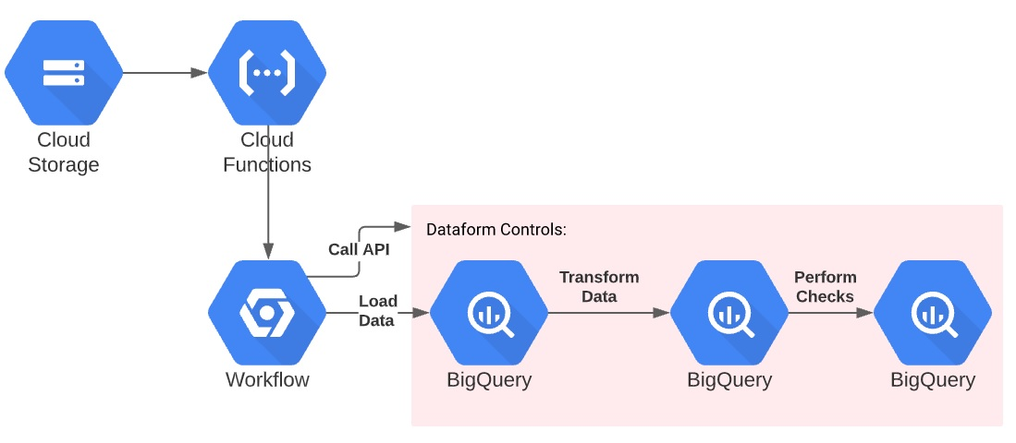
Collect, Process, and Store
Data In BigQuery

Slide 5
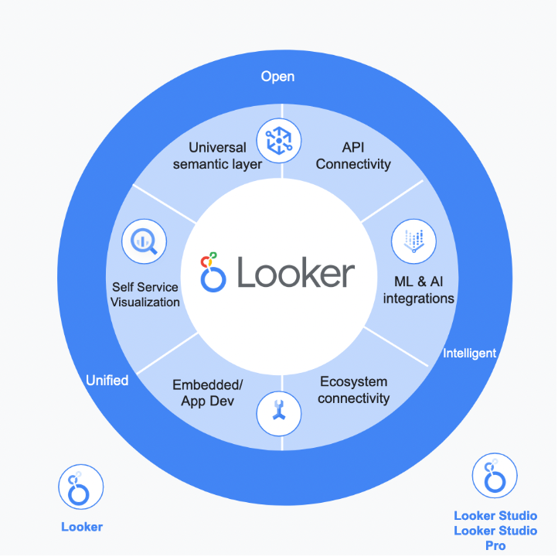

Looker Enterprise
Looker Enterprise offers its own visualization options within it via its Looks, Explores and Dashboards.

Slide 6

Thank You :)

